Slide 1


SUMMER TRAINING
NAME : PAVULURI CHAITANYA
REG.NO : 12103286
COURSE CODE : CSE443
COURCE : SEMINAR ON SUMMER TRAINING

Slide 2
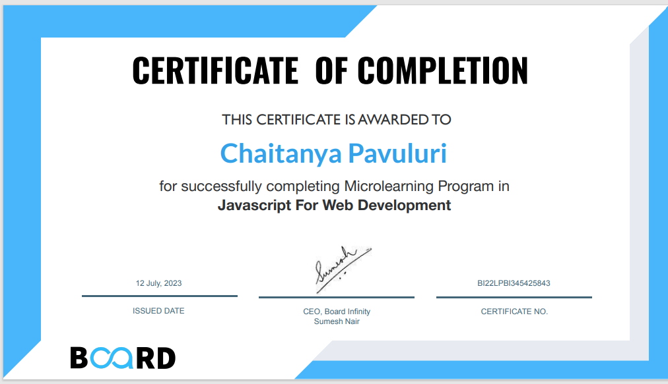
Certificate:

Slide 3

Javascript for WebDevelopment

Slide 4
Agenda
INTRODUCTION
WEEK 1: JAVASCRIPT FUNDAMENTALS
WEEK 2: ADVANCED JAVASCRIPT
WEEK 3: JAVASCRIPT APPLICATIONS
WEEK 4: PROJECTS SHOWCASE
LEARNING OUTCOMES
CONCLUSION

Slide 5
4-week JavaScript
Training
01
02
03
04
Week 1 Introduction to Web Development
Week 2 JavaScript Advanced
Week 3 JavaScript DOM Manipulation
Week 4
Projects Showcase

Slide 6
Javascript is an object-oriented language that is lightweight and used for web development, web applications, game development, etc. It enables dynamic interactivity on static web pages, which cannot be done with HTML, and CSS only. Javascript is so vast that even mid-level professionals find it difficult to work and that might be possible because of the demand.
Most websites use JavaScript for validation and to support external applications, including PDF documents, widgets, flash applications. Some of the world’s largest tech companies use JavaScript to better the user experience.

Slide 7
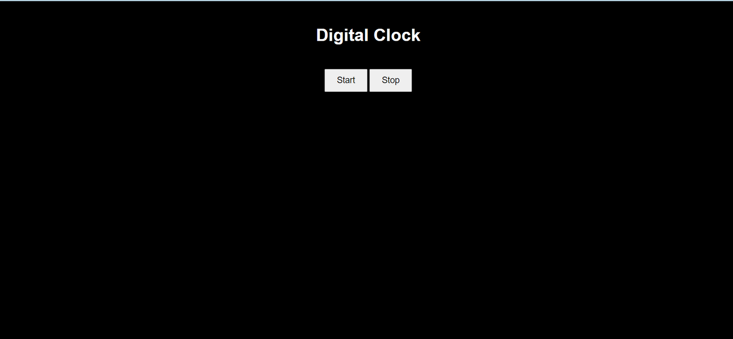
Building a Digital Clock with Start/Stop Function
When ever we click this button current time will be shown
Time will be stopped until we click on start button and after clicking start button the current time will be shown

Slide 8
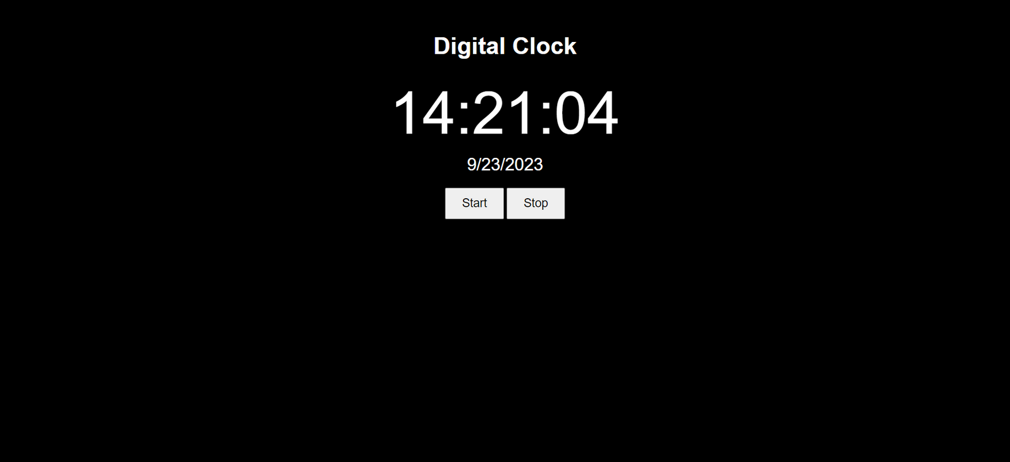
Building a Digital Clock with Start/Stop Function
After clicking on the start button this output was shown

Slide 9
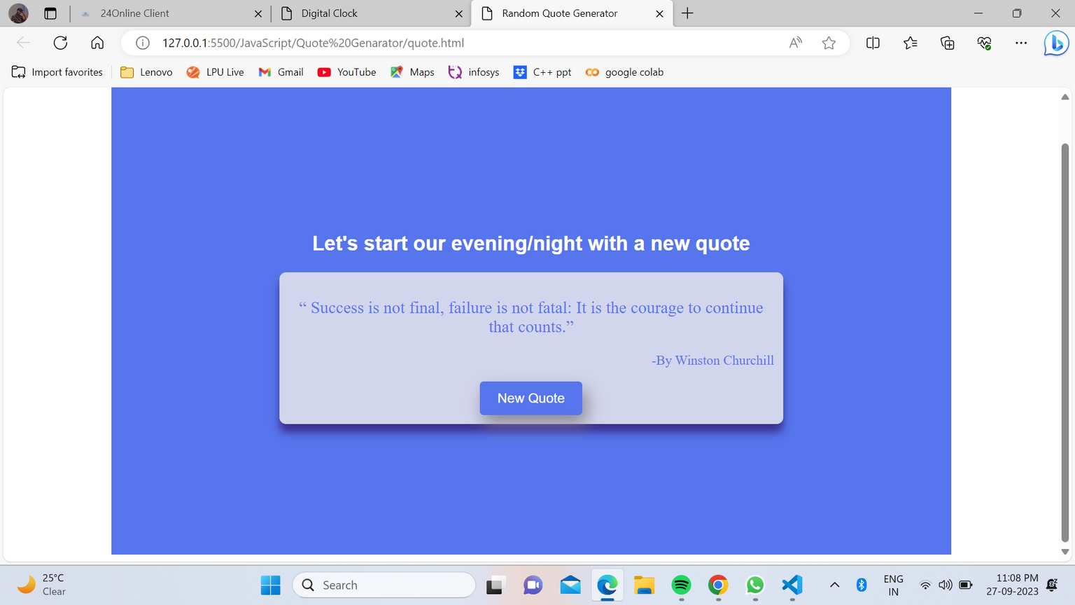
Building a Random Quote Generator
Here whenever we come it shows Greetings according to time now it is 6pm so showing evening if it is 12pm then noon.
New Quote button is used to get a new quote every time.

Slide 10
Learning outcome
Understand the Scope of the Internship: Gain insight into the structure and content of a 4-week JavaScript summer internship, including its modules and hands-on projects.
Comprehend the Significance of JavaScript: Recognize the importance of JavaScript as a fundamental language in web development and its role in creating dynamic and interactive web applications.
Additional Learning
Explored popular JavaScript libraries and frameworks.
Strengthened development tools and best practices knowledge.

Slide 11
Conclusion:
In closing, my 4-week JavaScript summer internship at Board Infinity has been a transformative journey. I embarked on this experience with the aim of mastering JavaScript, and I can confidently say that I've achieved that goal.
Throughout this internship, I've not only learned the fundamentals of JavaScript but also delved into advanced concepts, honed my practical skills, and built projects that showcase my abilities. From crafting a digital clock with start/stop functionality to developing a random quote generator, I've embraced the art of web development.

Slide 12

Thank You

